Slide 1

Text Summarization Using Transformer Decoders
Team Details
Team Number: 40
Sl.Num. | Student Name | USN | Roll Num. | Division
1 | Pratham V Shirol | 01FE21BCI018 | 117 | F
2 | Tarun S Maidur | 01FE21BCI008 | 107 | F

Slide 2
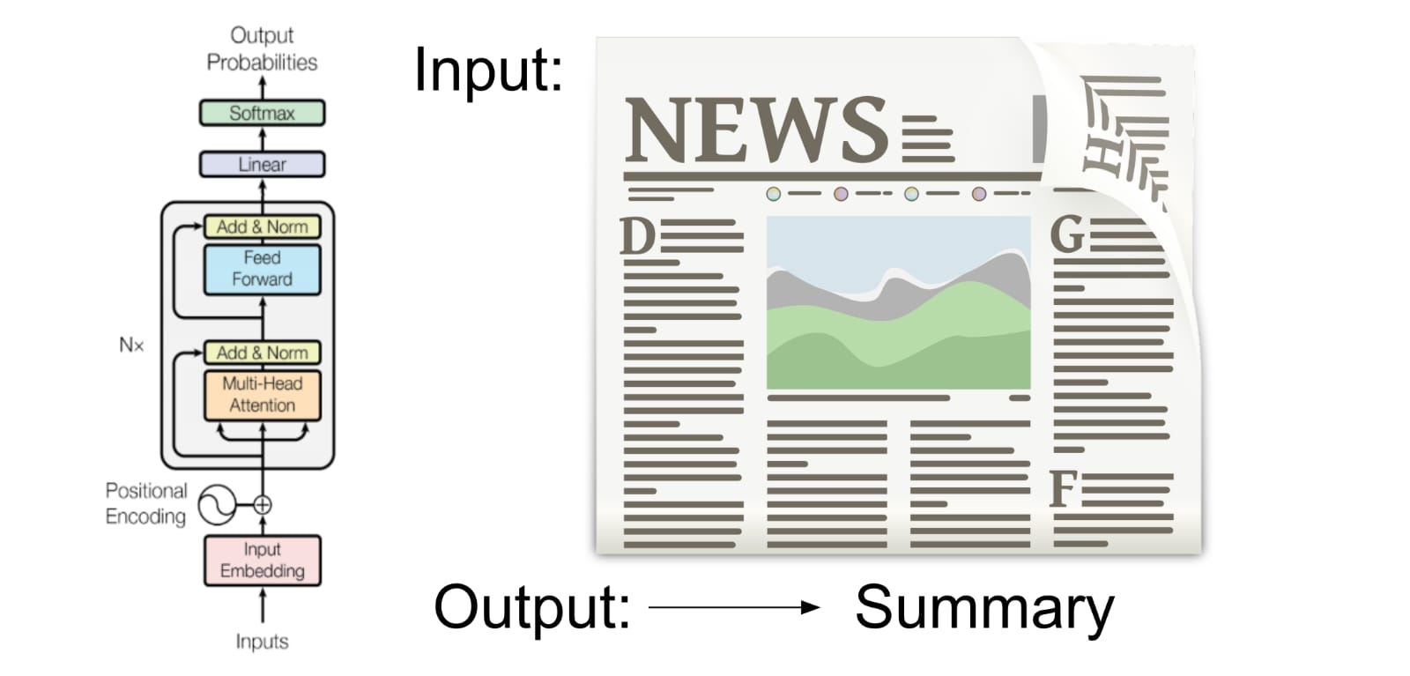
Introduction
In today's digital world, vast amounts of information are generated daily, making it challenging for users to quickly extract key insights. Text summarization is a critical natural language processing task that condenses large texts into concise summaries, enabling faster content understanding.
This project, "Efficient Text Summarization Using Transformer Decoders," leverages the Transformer architecture with a focus on the decoder component to produce high-quality summaries. By using the CNN/DailyMail dataset and implementing the model with Trax, this project ensures both clarity in code and performance optimization on TPUs and GPUs.
This tool can help consumers and enterprises quickly digest lengthy articles and apply additional analyses like sentiment detection, enhancing content accessibility and utility.

Slide 3
Problem Statement
In an era of information overload, quickly distilling key insights from extensive texts is essential. This project aims to create an efficient text summarization tool using a transformer decoder model, helping users condense lengthy documents into concise summaries for faster comprehension.
Objectives:
Develop an Effective Abstractive Summarization Model: Create a text summarization system leveraging the Transformer architecture, capable of producing coherent and concise summaries.
Utilize Transformer-Based Approaches: Integrate advanced models like PEGASUS, T5, and GPT, known for their capabilities in abstractive summarization.
Overcome Challenges in Summarization: Address issues such as faithfulness, coherence, and computational efficiency in generated summaries.
Support Multilingual and Domain-Specific Summarization: Explore the adaptability of the summarization model for specialized domains like healthcare, legal, and education.
Evaluate Performance: Use metrics like ROUGE and BLEU scores to quantitatively assess the quality of the generated summaries against benchmark datasets.

Slide 4
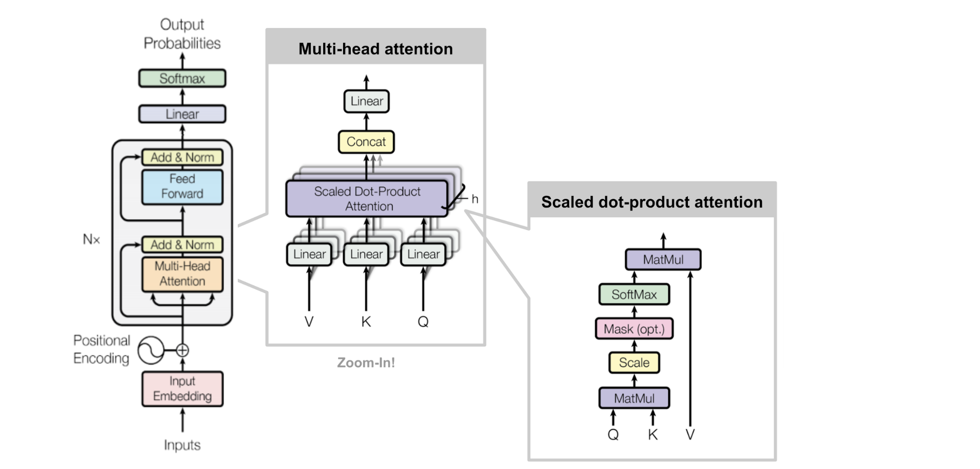
Architecture and Methodology

Slide 5
Working :
The process begins with loading a dataset of news articles, where the primary focus is on the article text and its corresponding headline (summary). After cleaning the data by removing unnecessary columns, each summary is augmented with special tokens: <go> to mark the start and <stop> to signify the end of the sequence. These tokens help the model understand the boundaries of the summaries during training.
Next, the text is tokenized. Tokenization involves converting the words in the articles and summaries into numerical tokens. This step includes training a tokenizer on the text to build a vocabulary, assigning each word a unique integer identifier. Words not found in the vocabulary are represented by a special <unk> token. The entire text is then transformed into sequences of these integers.
The sizes of the vocabularies for both the encoder (which processes the article text) and the decoder (which processes the summaries) are determined. These vocabulary sizes are critical for setting up the embedding layers in the model, which convert tokens into dense vectors that capture semantic meanings.
The model itself is based on the transformer architecture, consisting of an encoder and a decoder. The encoder processes the input article text, generating context-aware embeddings that encapsulate the meaning of each word in the context of its surrounding words. The decoder then takes these embeddings and, starting with the <go> token, predicts the next word in the summary one token at a time until it predicts the <stop> token, thus generating the complete summary.
Throughout training, the model learns to generate coherent summaries by optimizing its predictions against the actual summaries in the dataset. The final trained model can then generate concise and meaningful summaries for new articles, effectively automating the summarization process.

Slide 6
Conclusion :
The project demonstrates the implementation of a text summarization model using the transformer architecture. By leveraging a dataset of news articles and their corresponding headlines, the process includes critical steps such as data loading, preprocessing, tokenization, and vocabulary building. The incorporation of special tokens for sequence boundaries and the conversion of text into numerical tokens are essential for preparing the data for the model.
The transformer model, with its powerful encoder-decoder structure, effectively processes the input text and generates summaries. The encoder captures the contextual meaning of words in the articles, while the decoder uses this context to generate accurate and coherent summaries. This approach showcases the effectiveness of transformers in natural language processing tasks, particularly in summarizing lengthy texts.
Overall, the project highlights the potential of transformer-based models to automate the summarization of textual data, providing a valuable tool for efficiently extracting key information from large volumes of text. The successful training and evaluation of the model underscore its capability to produce meaningful summaries, demonstrating a significant advancement in the field of text summarization.

Slide 7
THANK YOU

